Slide 1
My Game Project
D.CHARITH.

Slide 2
TITLE
THE DINO GAME

Slide 3
Project all about ?
Project Description: The main aim of this game is to survive without collision with all the coming obstacles.

Slide 4
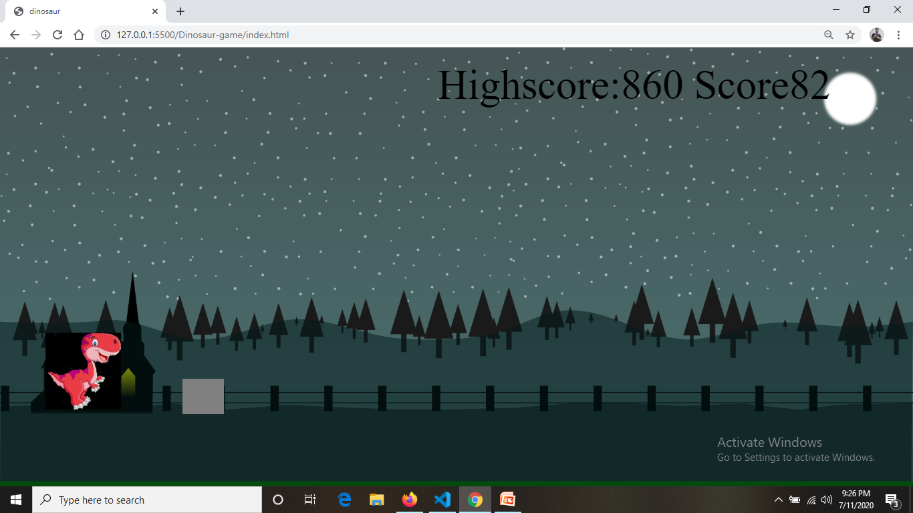
OUTPUT

Slide 5
THANK YOU

